Slide 1

Win-Win
Team: Star
Notes:
Background placeholder: After choosing your image, Right click on the image -> Send to back -> Click on send to back

Slide 2
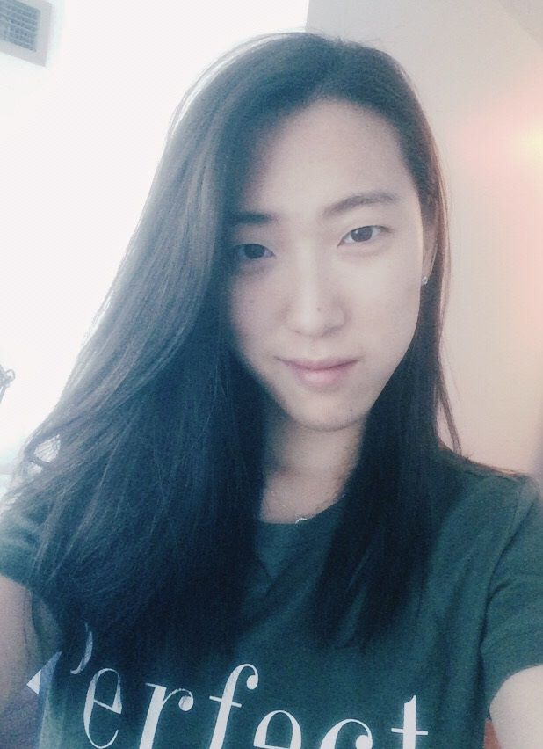

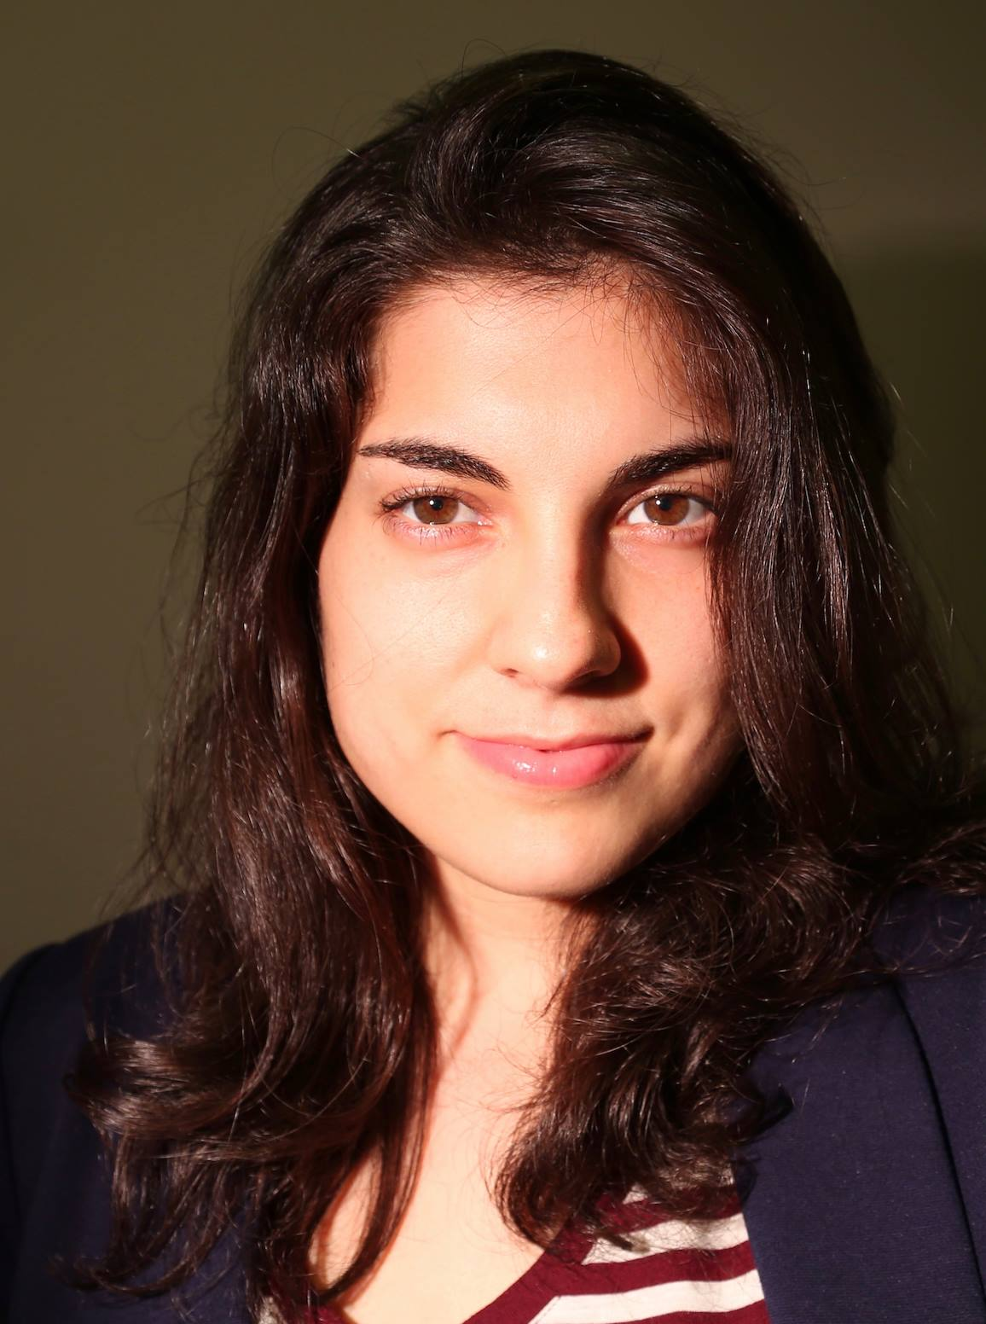
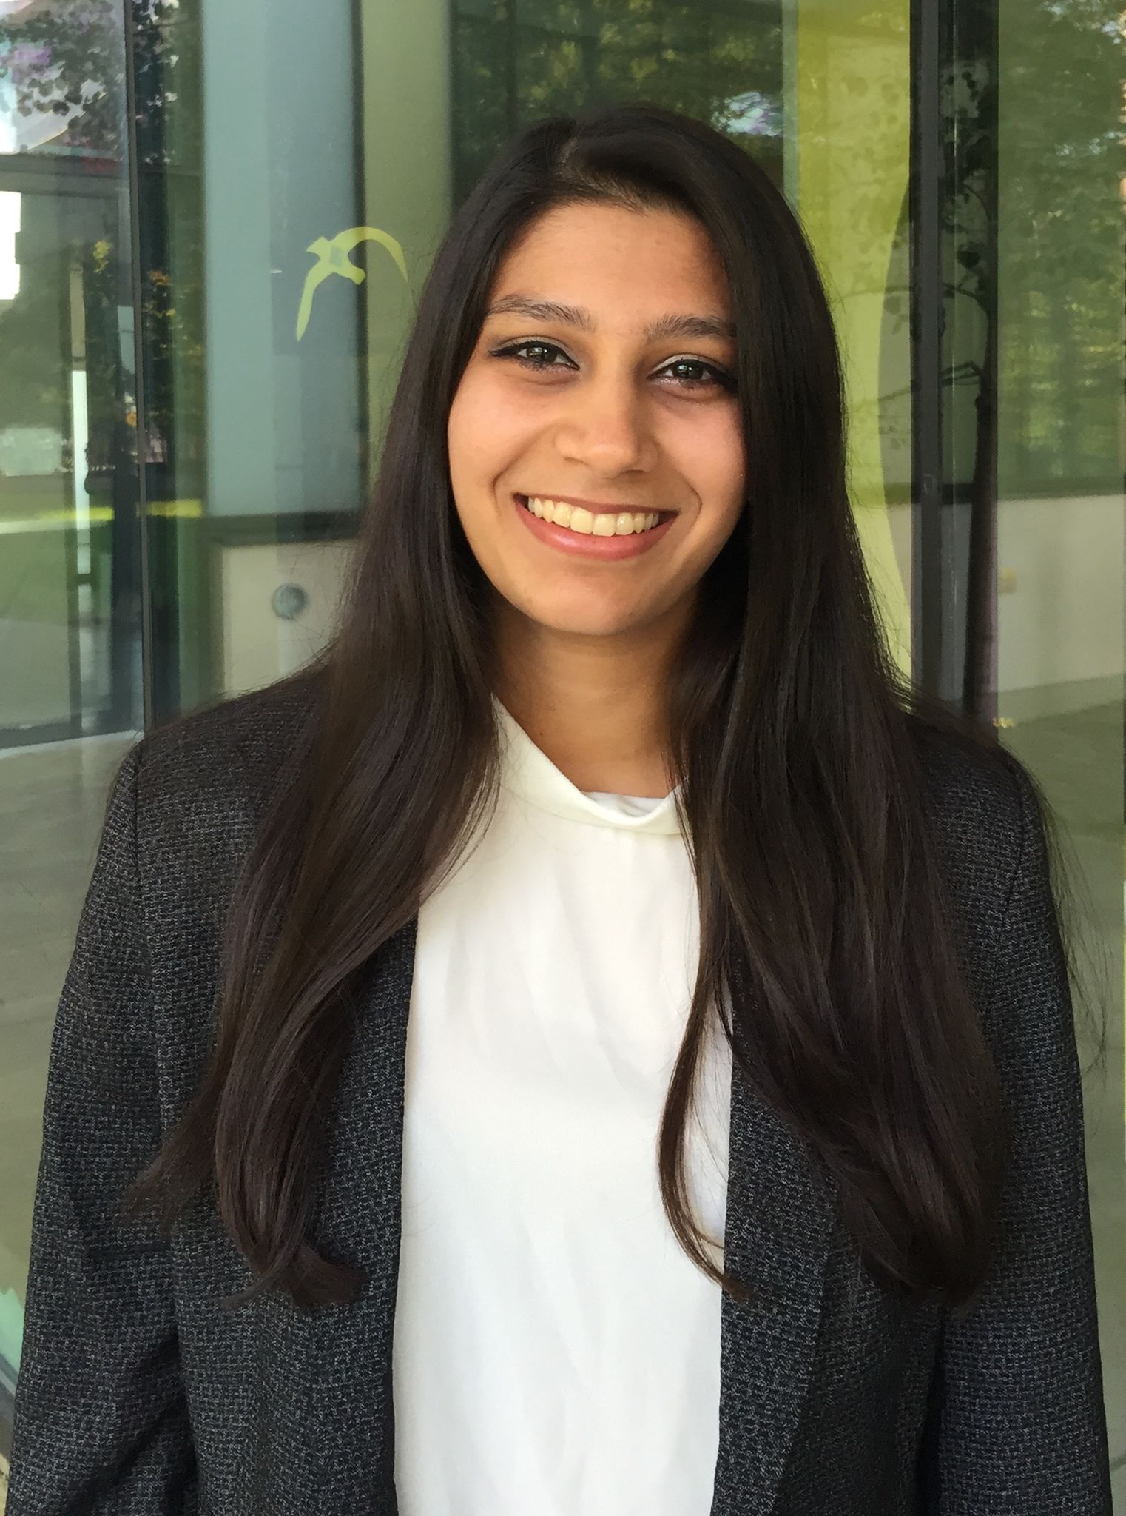
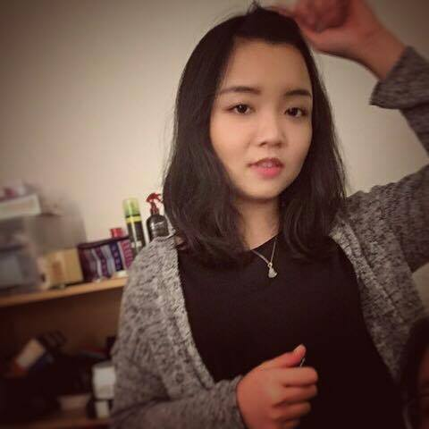
Alex
Software Developer
Lizzia
Product Owner
Laura
Software Developer
Simran
Business/Financial
Analyst
Sixin
Graphic Designer

Slide 3

Anna
Single mother of 2 kids
Works 2 jobs
Lack of money for babysitter
Needs to go out tonight
Calling friends/family to baby sit – no one can make it
Anna is angry
Problem
Current Solutions
Win-Win
Financial Analysis
Risk Mitigation

Slide 4

Bob
University student in final year
Passion for photography
Does not clean his apartment
Does not have money to hire maid service
Problem
Current Solutions
Win-Win
Financial Analysis
Risk Mitigation

Slide 5
Carl
Older man
Free time on his hands
Looking for a photographer for daughter’s prom photoshoot
Problem
Current Solutions
Win-Win
Financial Analysis
Risk Mitigation

Slide 6



People Lack:
Money
Skill Set
Can’t find instant help
Problem
Current Solutions
Win-Win
Financial Analysis
Risk Mitigation

Slide 7
Current Solutions
Kijiji
Calling friends/family to help out with tasks
Nanny Service
Googling Ads
Maid service
Problem
Current Solutions
Win-Win
Financial Analysis
Risk Mitigation

Slide 8
Current Solutions
Kijiji
Calling friends/family to help out with tasks
Nanny Service
Googling Ads
Maid service
Problem
Current Solutions
Win-Win
Financial Analysis
Risk Mitigation

Slide 9
Win-Win
A member-based services exchange platform inspired by our human needs of community and connection where paying it forward is a form of currency.
Problem
Current Solutions
Win-Win
Financial Analysis
Risk Mitigation

Slide 10
Anna
Bob
Carl
Seeking: Babysitting
Providing: Cleaning
Seeking: Cleaning
Providing: Photography
Seeking: Photography
Providing: Babysitting
Problem
Current Solutions
Win-Win
Financial Analysis
Risk Mitigation

Slide 11
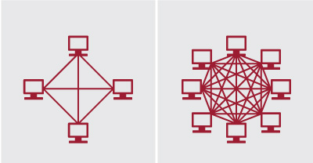

Slide 12
Financial Analysis
Year | Expected # of users
1 | 5000
2 | 5500
3 | 7150
4 | 12870
5 | 18018
Problem
Current Solutions
Win-Win
Financial Analysis
Risk Mitigation

Slide 13
Risk Mitigation
Security of customers – rating service, background checks, referrals
Provider does not show up – 2 strike policy
Problem
Current Solutions
Win-Win
Financial Analysis
Risk Mitigation

Slide 14
Future Plans
Add more services
Provide clients with option to add additional services (seniors service)
Expand to more locations
Network Effect
Collaborative Filtering – recommendations
Business partnerships
Blockchain capabilities

